Slide 1
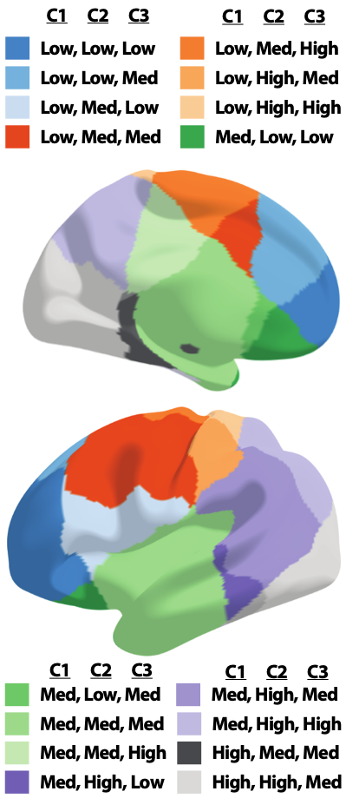
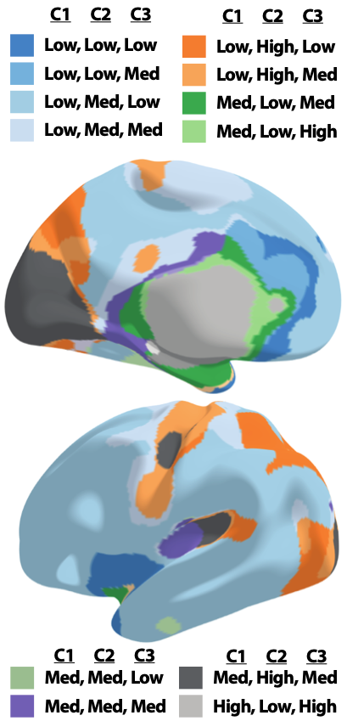

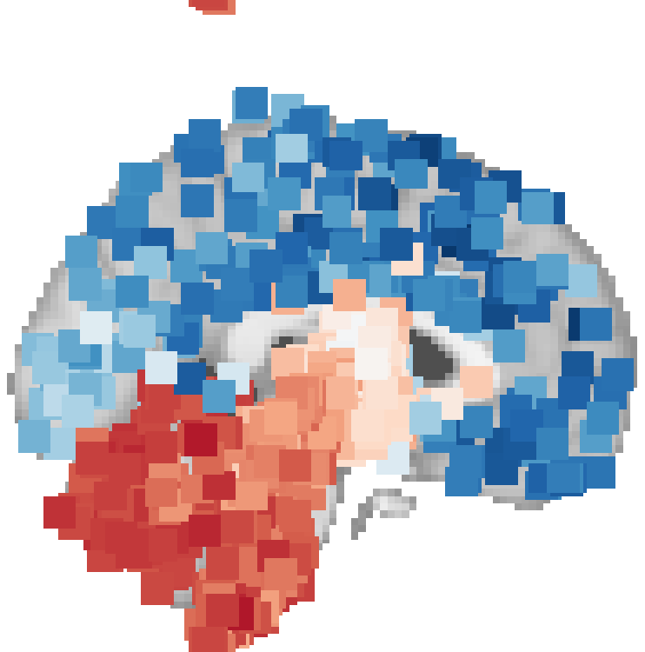
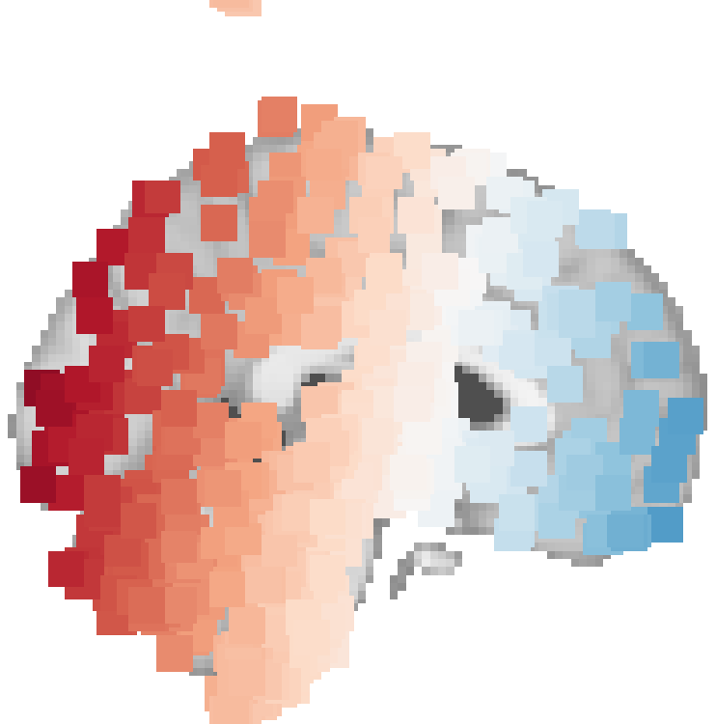
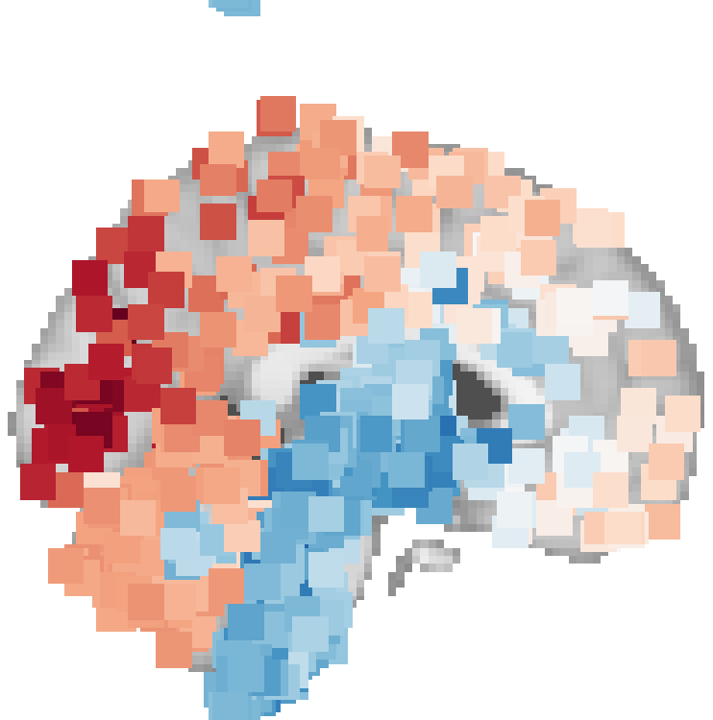
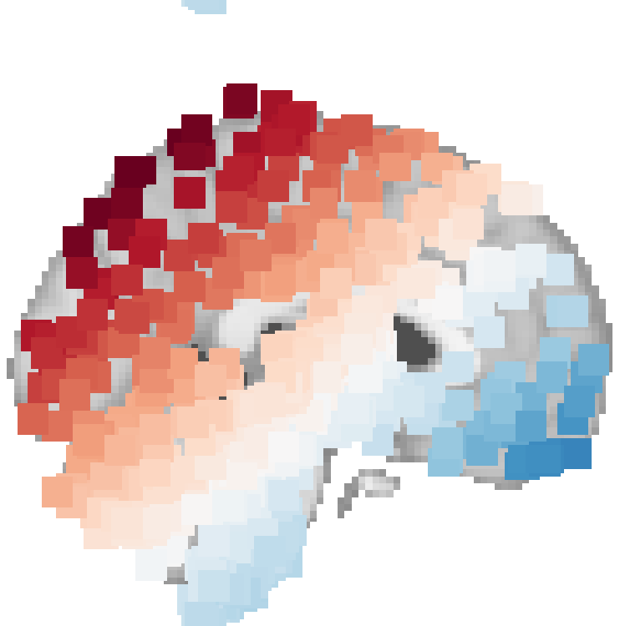
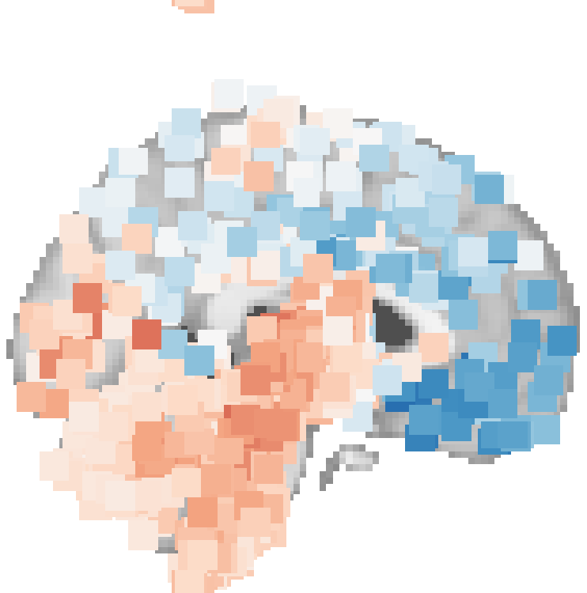


Identifying spatial genomic gradients of the adult human brain
Jake Vogel, July 12, 2021

Slide 2
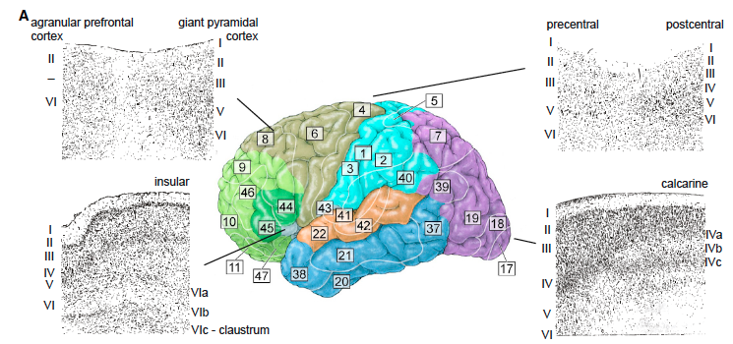
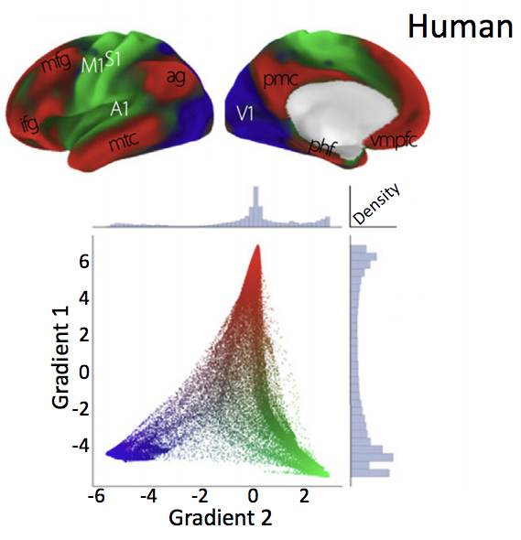
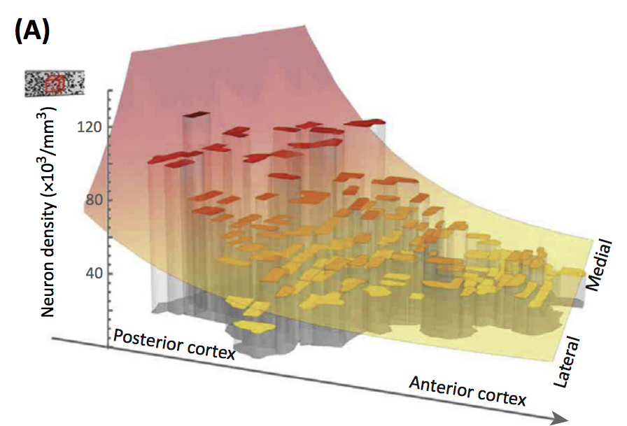
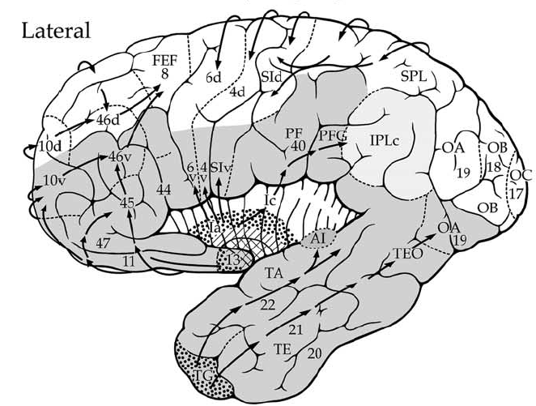
Functional topography of the brain
Brain Regions
Brain Gradients
Brain Organization
Cadwell et al. 2016 Neuron
Giaccio et al. (2006)
Neurosci. Biobeh. Rev
Cahalane et al. (2012)
Front. Neuroanat.
Margulies et al. (2016)
PNAS
Notes:
The human brain is characterized by a strong relationship between functional specialization and space. This relationship can be observed as a modular representation, where brain tissue self-segregates into structures and sub-structures with shared behavioral functions and/or cytoarchitecture. We often call these Brain Regions. There is also evidence for gradient-like representations, where gradation in function appears to be organized systematically across specific linear axes. Some examples are gradients in evolutionary organization, neuronal cell distributions and gradients of cortical connectivity. These regions and gradients co-exist, and likely interact hierarchically to influence brain functional organization.

Slide 3
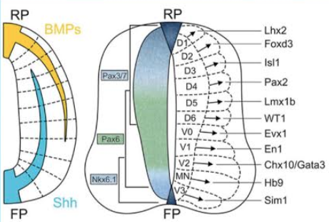
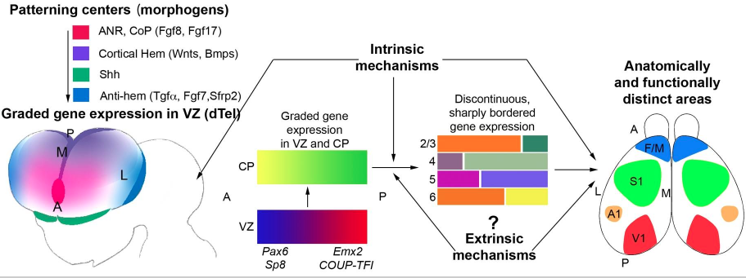
Genomic Gradients
Nieuwenhuys & Puelles 2016
O’Leary & Sahara, 2008 Curr Opin Neurobiol
Notes:
The origins of functional regions and gradients like come from gene expression during development. Here are examples from the developing spinal cord (top) and brain at the bottom. In both cases, broad, gradient-like expression of a few genes helps to recruit additional genes expressed in more discontinuous and sharply bordered patterns, creating regions. A number of such genes have been identified in the human brain, but it is generally difficult to study these phenomena in humans for obvious reasons.

Slide 4
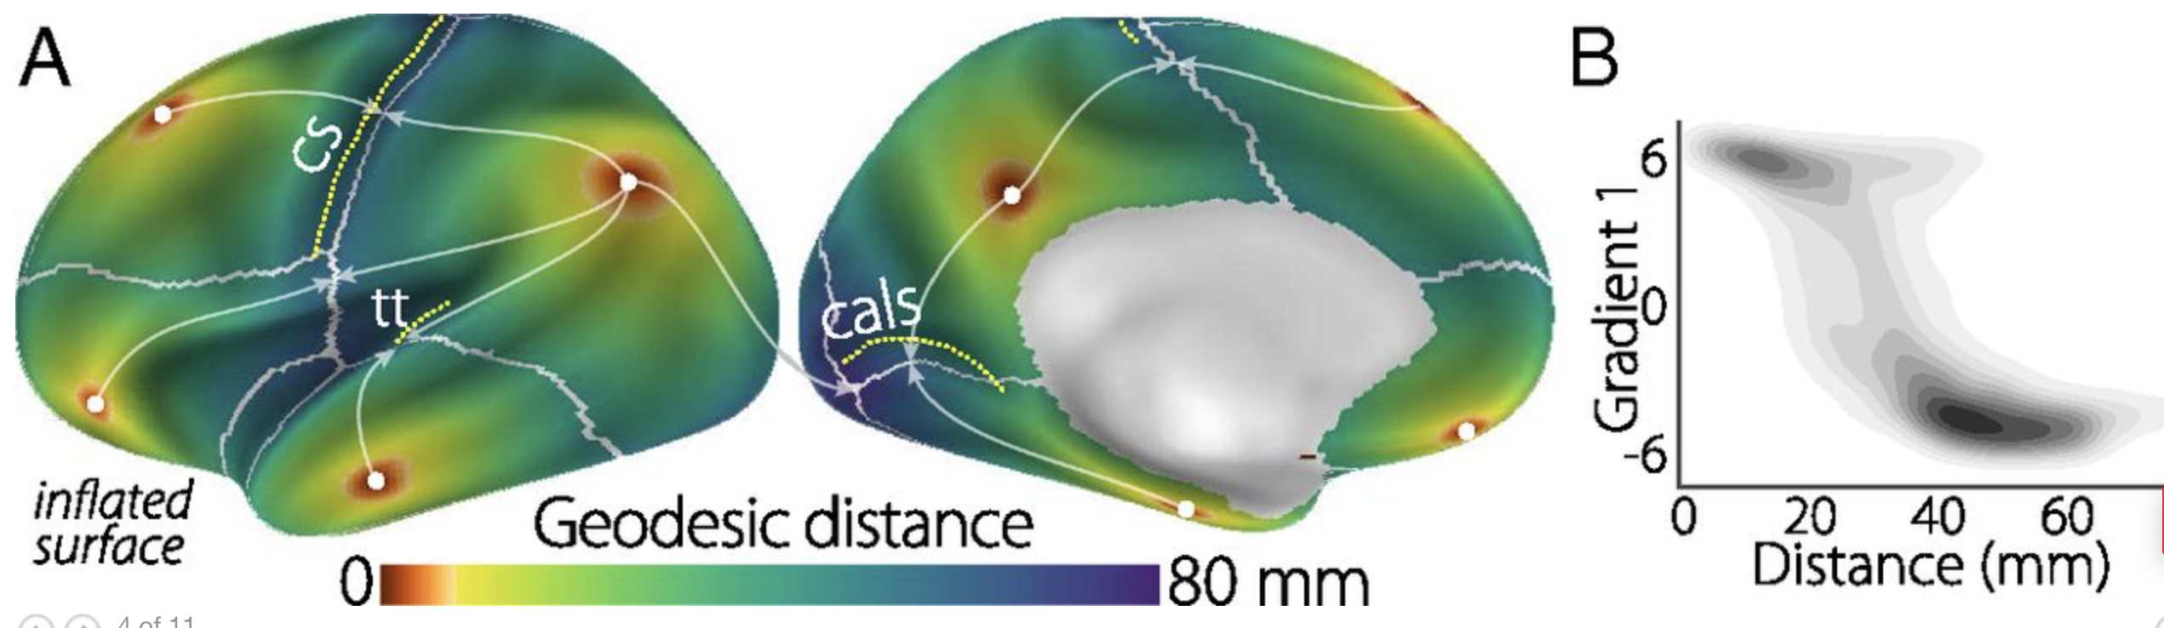
Nieuwenhuys & Puelles 2016
Margulies et al. (2016) PNAS

Slide 5
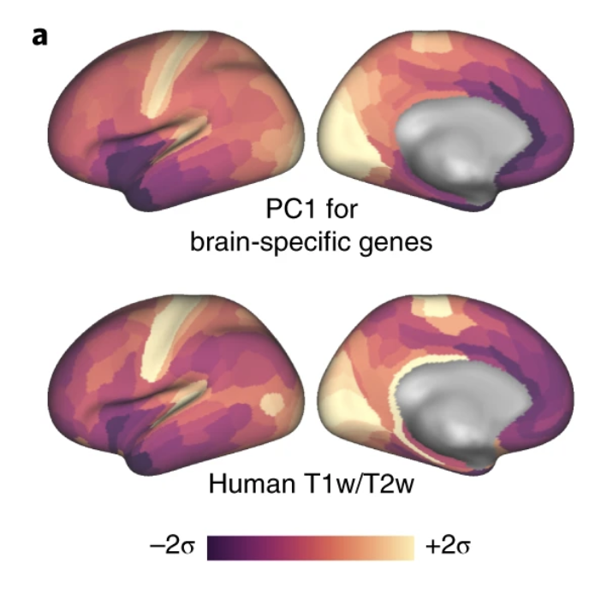
Burt et al. (2018) Nat Neuro
Margulies et al. (2016) PNAS

Slide 6
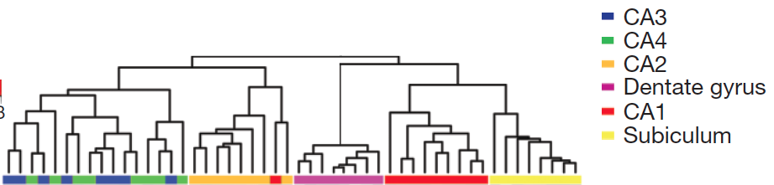
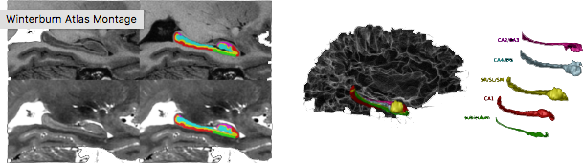
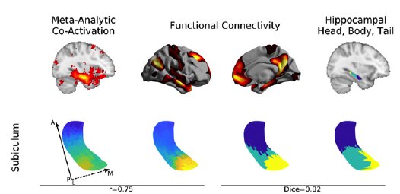
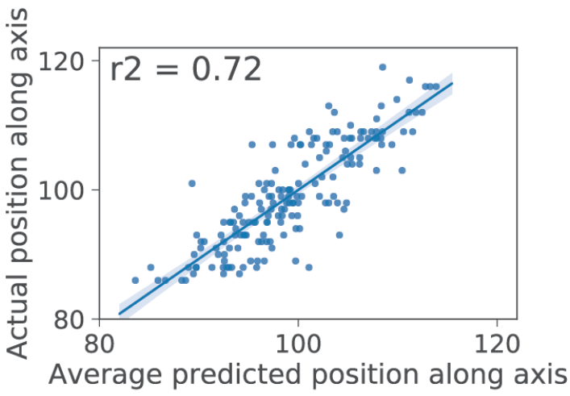
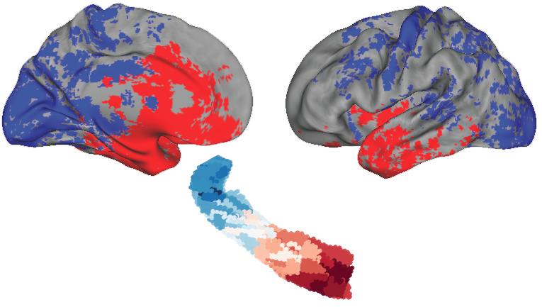
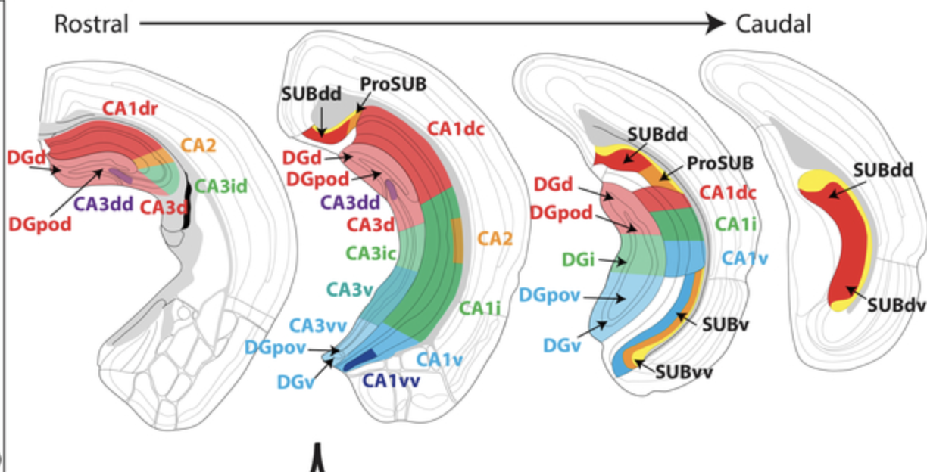
CoBrA Lab Website
(also Winterburn et al., 2013)
Hawrylycz et al., 2012, Nature
Vogel et al., 2020 Nat Comms
Vos de Wael et al., 2018 PNAS
Bienkowski et al., 2018 Nat Neurosci
See also Thompson et al., 2008 Neuron

Slide 7
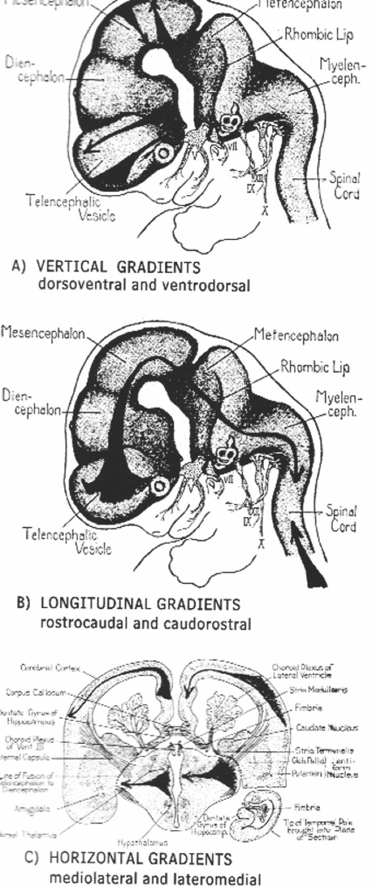

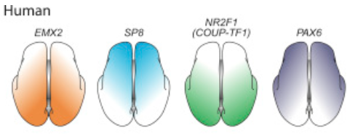
Sarnat-Flores & Sarnat 2008
Nieuwenhuys & Puelles 2016

Slide 8
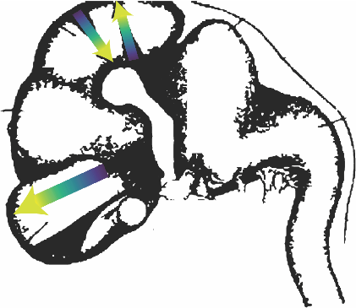
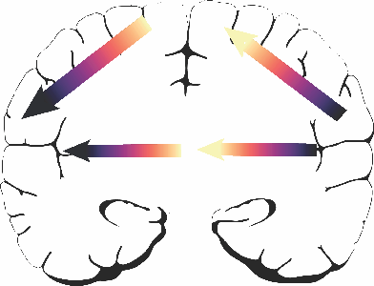
Sarnat-Flores & Sarnat 2008
A) Vertical Gradients
Nieuwenhuys & Puelles 2016
Cadwell et al., 2016 Neuron
B) Longitudinal Gradients
C) Horizontal Gradients

Slide 9
Key Takeaways
Gradients are an organizational phenomena that facilitate regionalization
Gradients retain functional relevance beyond organization
Space is a critical organizing principle of the brain
Gradients are detectable across multiple scales
Little is known about spatial genomic gradients in the adult brain
Q: Can we detect developmental genomic gradients in the adult brain?

Slide 10
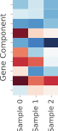
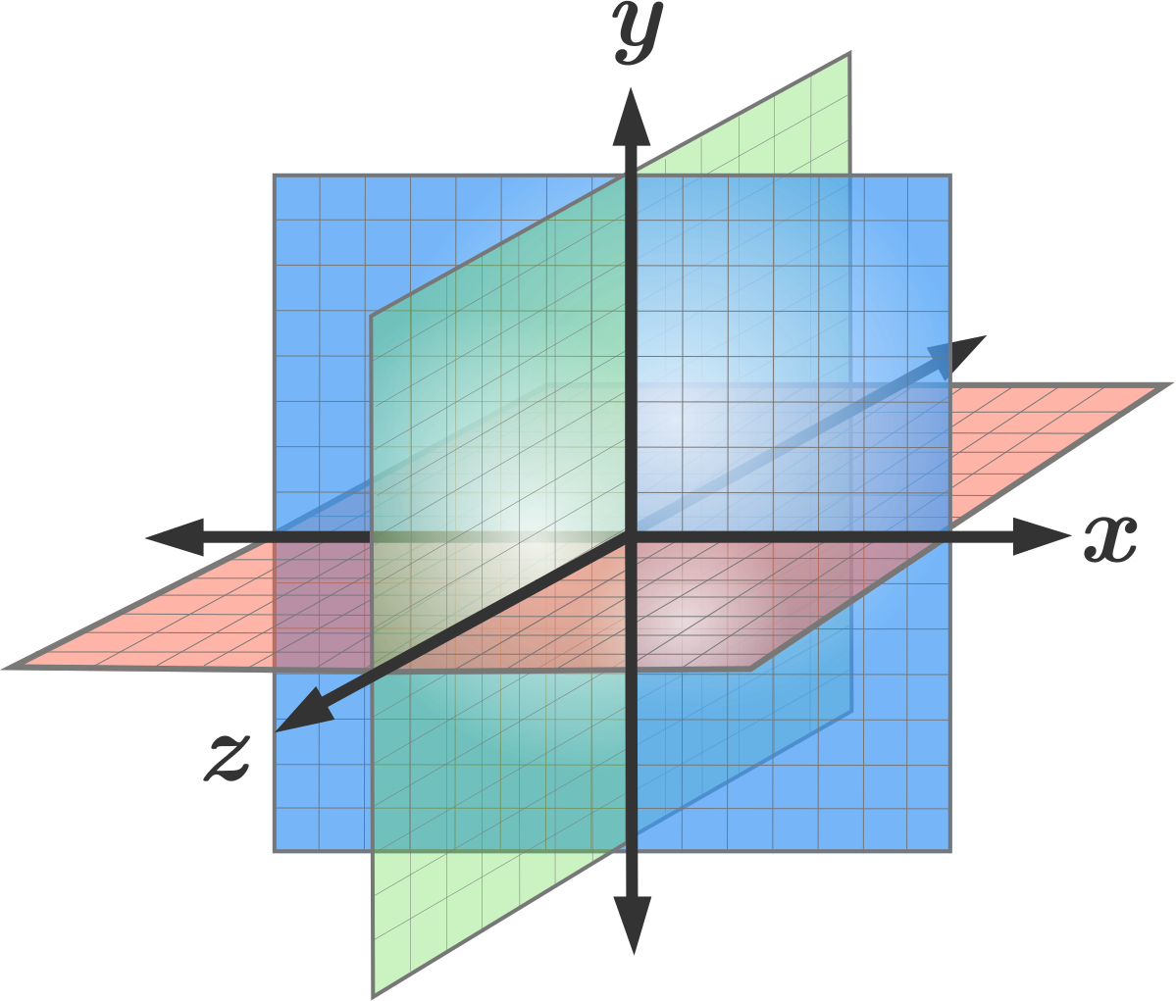
Current Study
Relationship between gene expression and space
Cross-Decomposition
Gene Expression vs Euclidean space (x, y, z coordinates)
X
Y
Model
Genomic Gradients?
Notes:
Here, we take these concepts further to try to understand more broadly the relationship between gene expression and the space across the whole brain. Are there major spatial gradients along which gene expression systematically covaries? Our study uses cross-decomposition to try to identify genomic gradients in the adult human brain.

Slide 11
Model fitting / evaluation

Slide 12
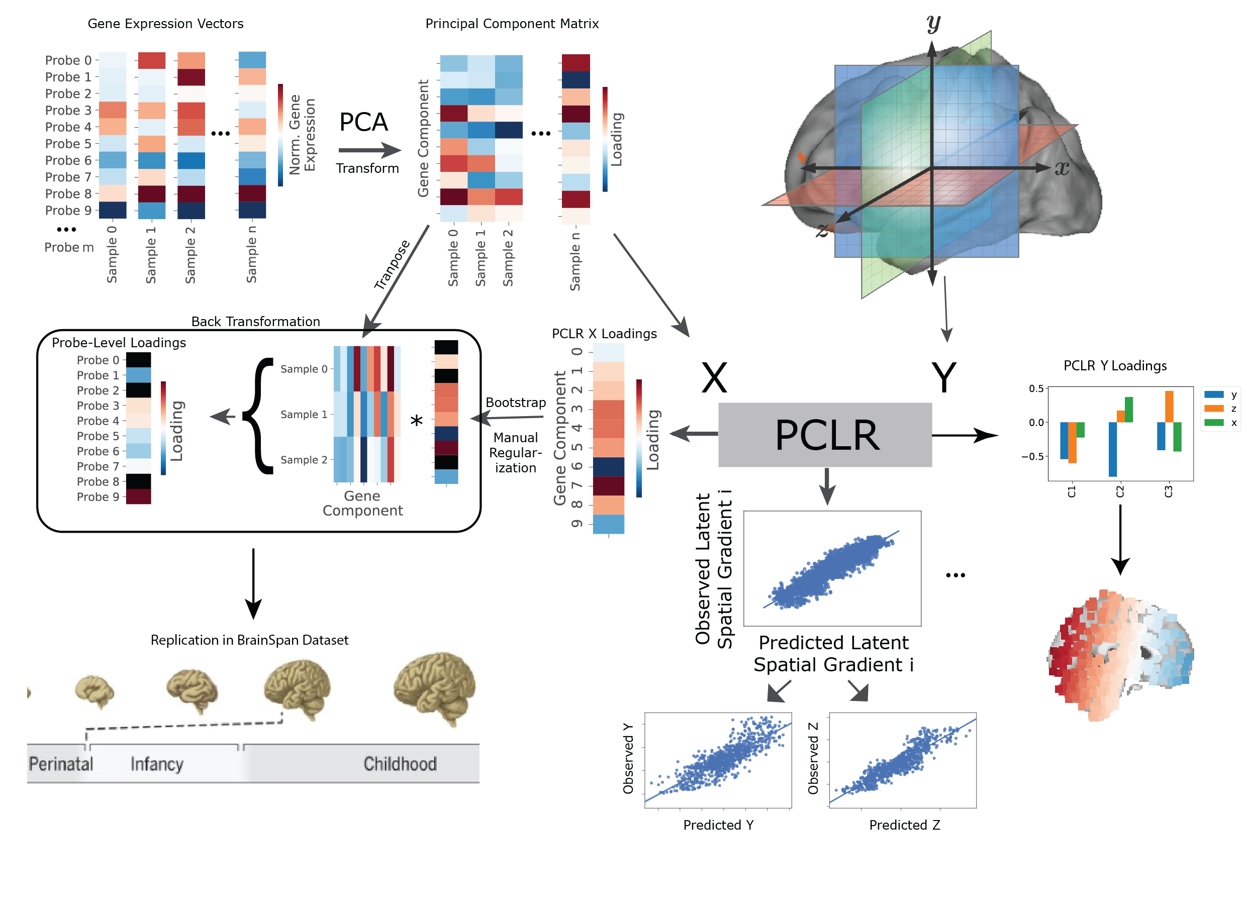
PLS -> Genes and Space
Notes:
We start by reducing the dimensions of the genomic data using PCA. We then pass the gene expression data to a cross-decomposition algorithm such as PLS regression, so as to model gene expression as a function of space, measured with the 3 principal axes of 3D Euclidean space. Once fitted and validated, the model components can be decomposed into covarying spatial or genomic gradients, and even applied to external datasets.

Slide 13
60% of
tissue
samples
Full Dataset
40% of
tissue
samples
Training
Test
Choose/ Train
Model
Validate
Model
Cross-validation
Fit Model
Evaluate/Describe
Model
Notes:
We first use a cross-validation framework where we separate tissue samples into training and test sets. We identify the best models for our question at hand using the training set, and test the model by predicting the spatial coordinates of left out tissue samples in the test set using gene expression information. If we’re satisfied with this step, we can fit the model to the entire data, decompose the spatial and genomic gradients and describe them.

Slide 14
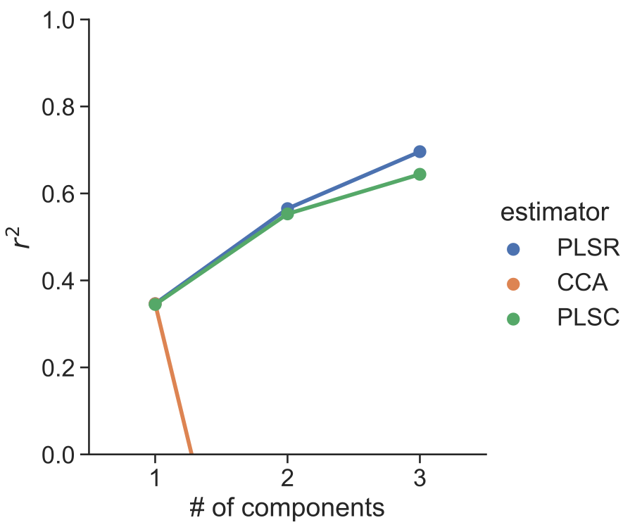
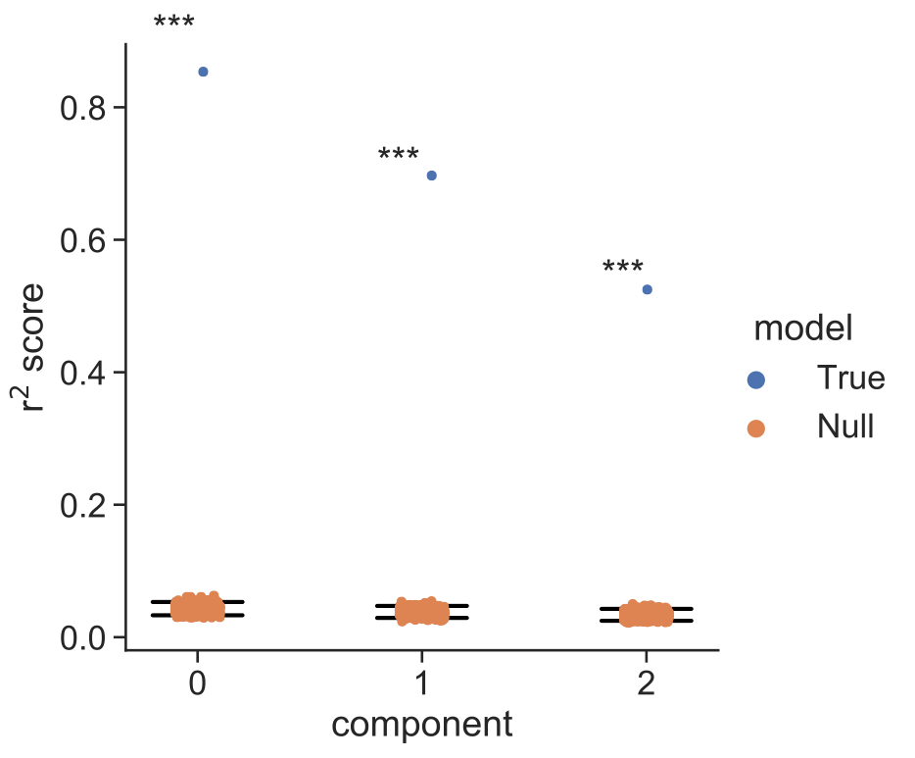
Cross-validation results
Training
Optimal method: PLSR
Optimal # components: 3
All 3 components explain data variance greater than chance
Notes:
We tested three different types of cross-decomposition models using up to three components, using cross-validation. We found the lowest mean error using three components, and PLS Regression. We also saw that all three PLS components explained variance in the spatial data far greater than expected by chance.

Slide 15
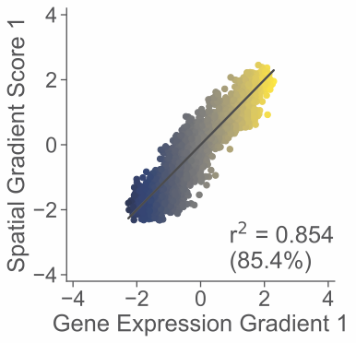
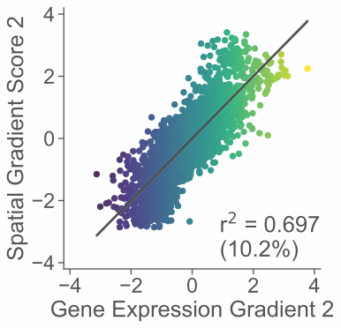
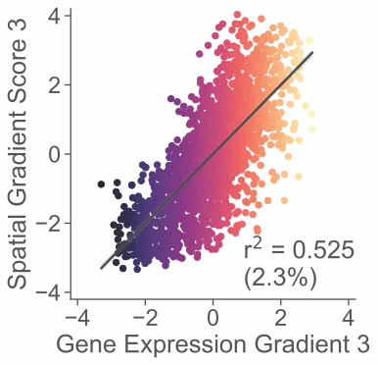
Cross-validation results
Training
Optimal method: PLSR
Optimal # components: 3
Notes:
Visualized here are each of these three PLS latent covariates

Slide 16
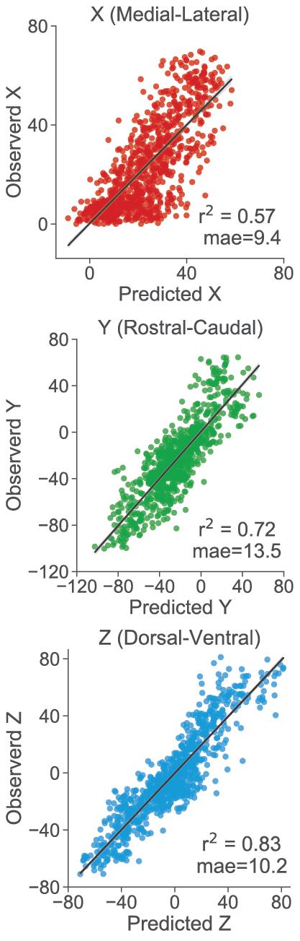
Evaluation in left out test-data
Training
Test
Predict
Notes:
We then used this PLS model to predict the 3D spatial location of left out samples based on gene expression. We found that the model predicted location very well along the rostral-caudal and dorsal-ventral axes, and less well along the medial-lateral axis.

Slide 17
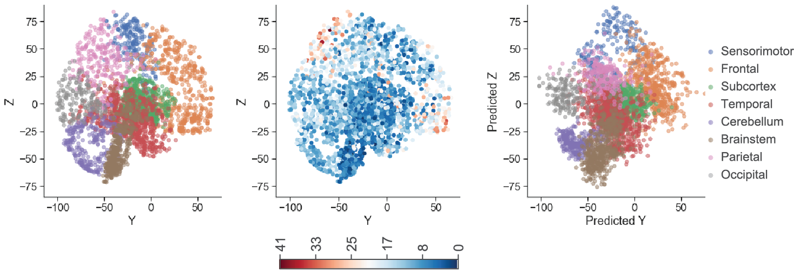
Predicted brain + error
Observed
Error
PLS Fitted
Notes:
This is true even if we subdivide into smaller brain structures. The model seemed to perform the worst in parietal and prefrontal regions.

Slide 18
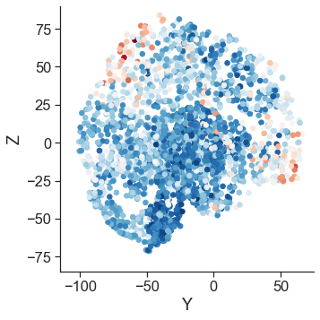
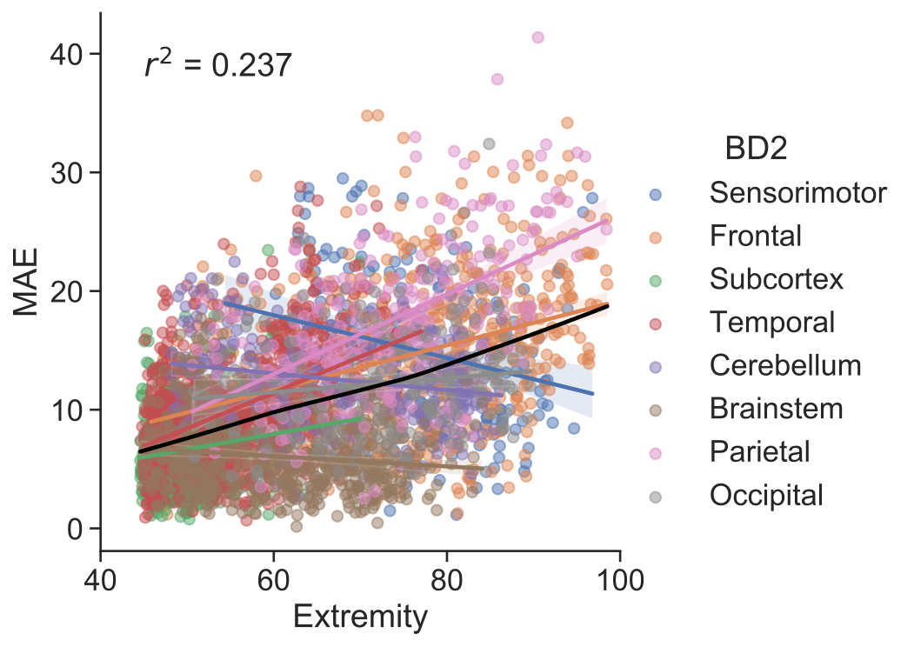
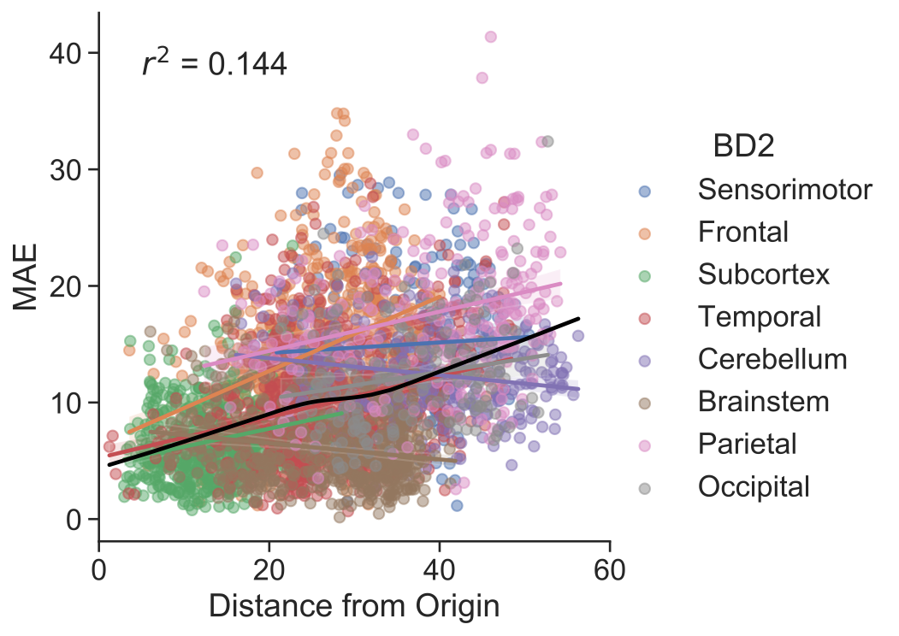

Slide 19
Model Interpretation

Slide 20
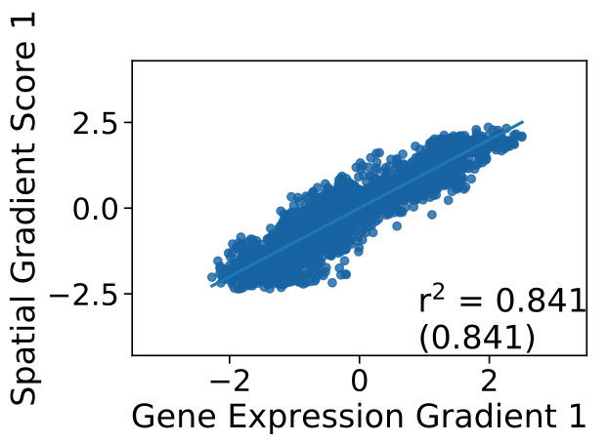
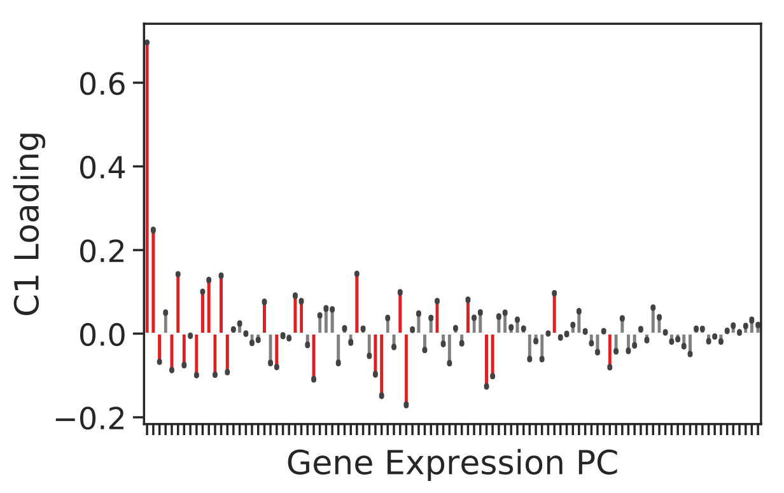
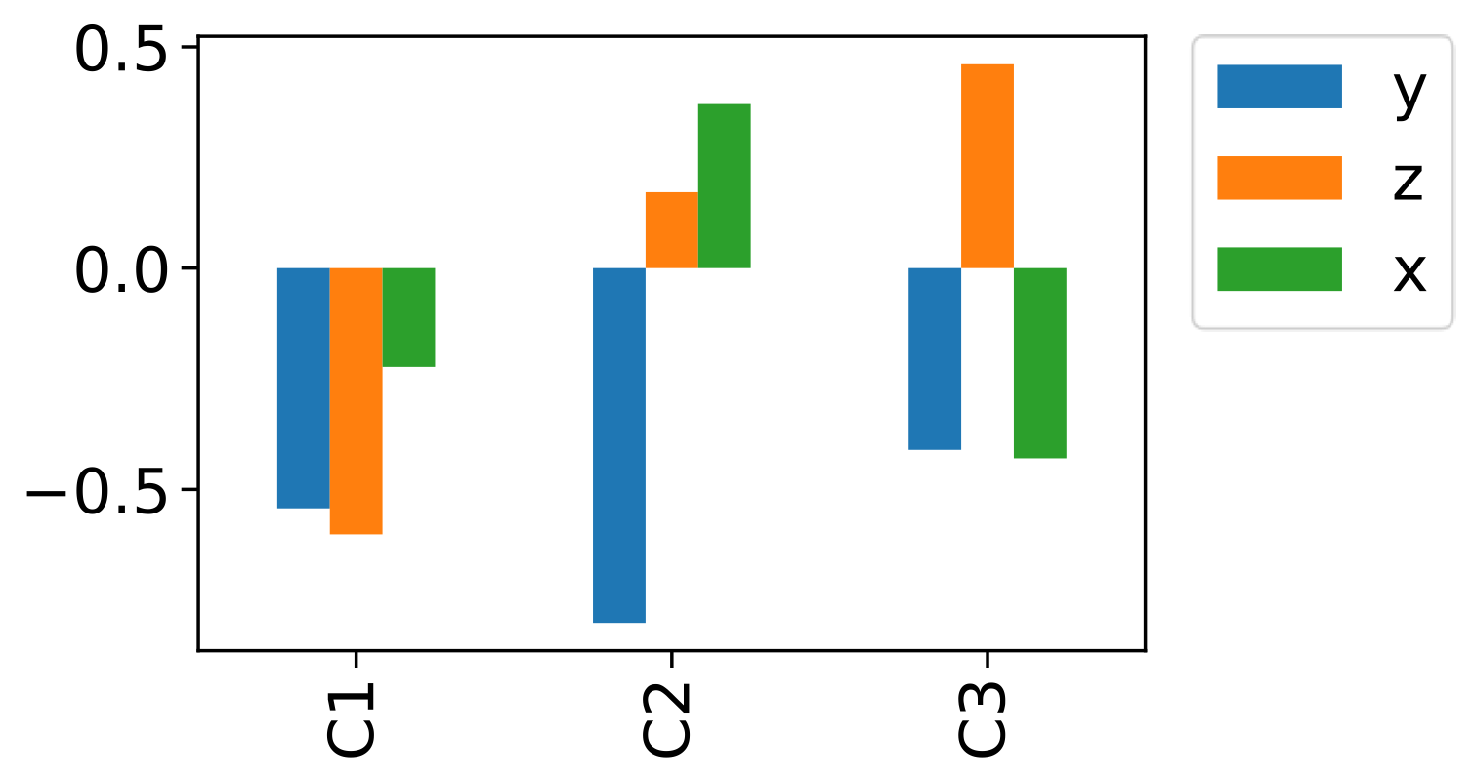
Full Dataset
Training
Test
Choose/ Train
Model
Validate
Model
Cross-validation
Spatial
Gradient
Genomic
Gradient
Notes:
next we fitted the model to all the data and decompose it into its spatial and genomic components.

Slide 21
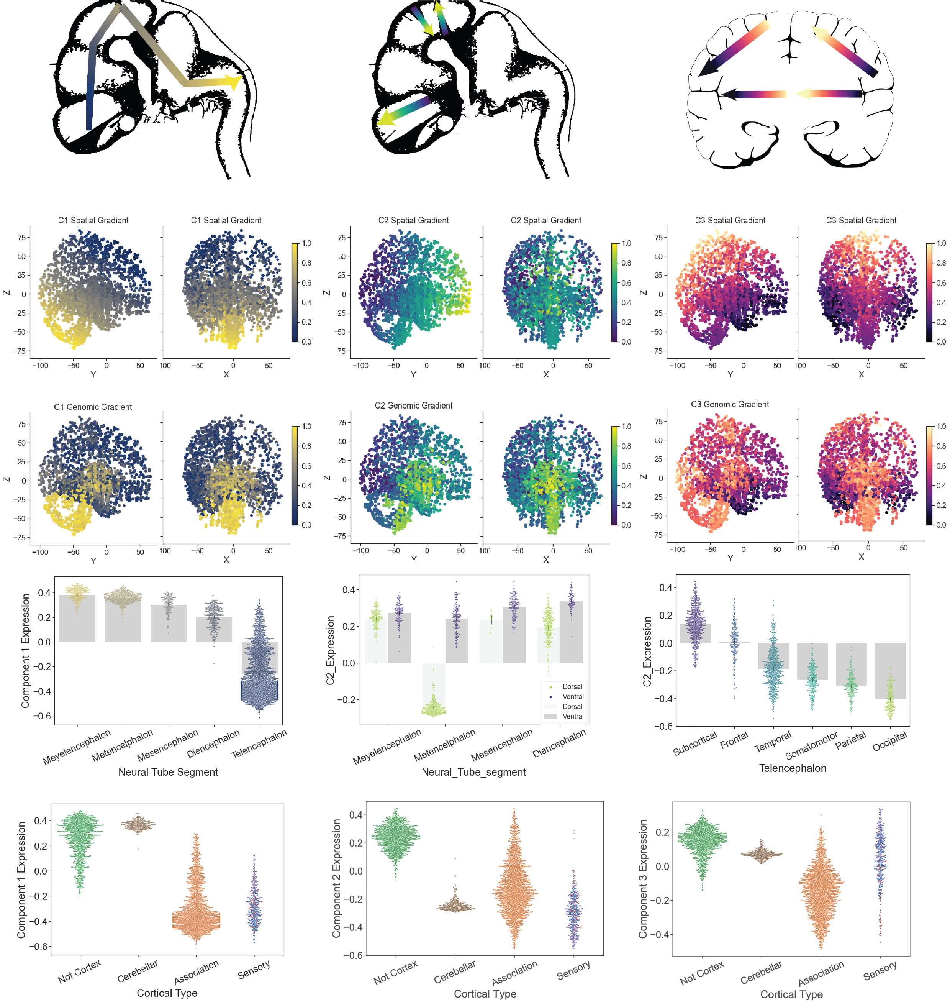

Slide 22
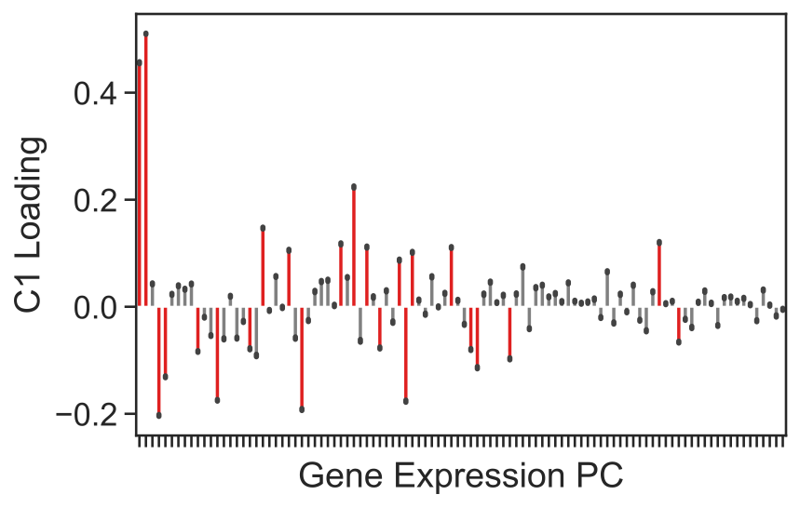
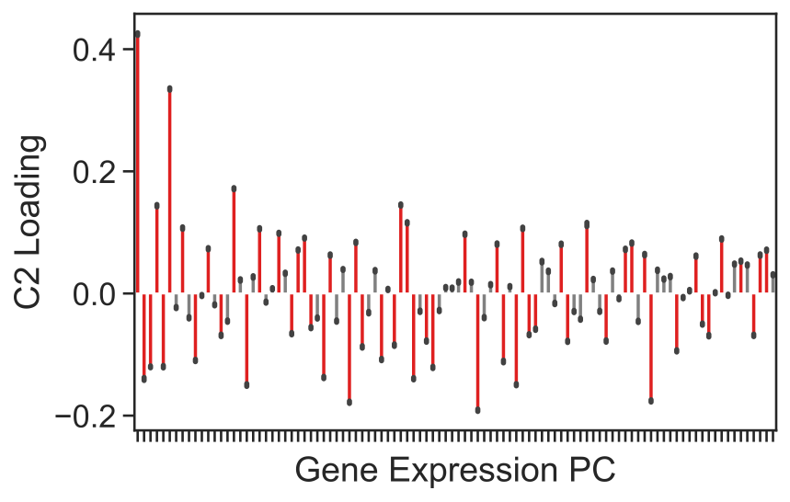
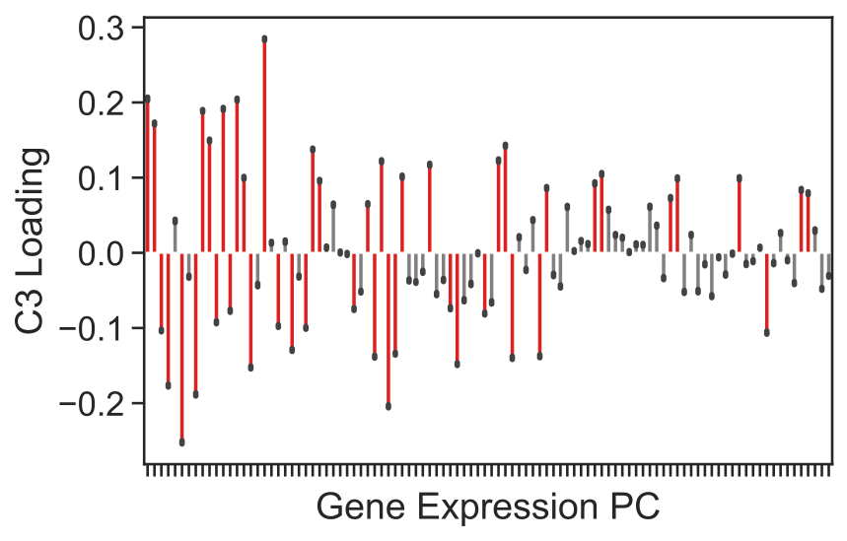

Slide 23
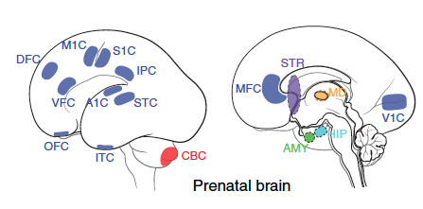
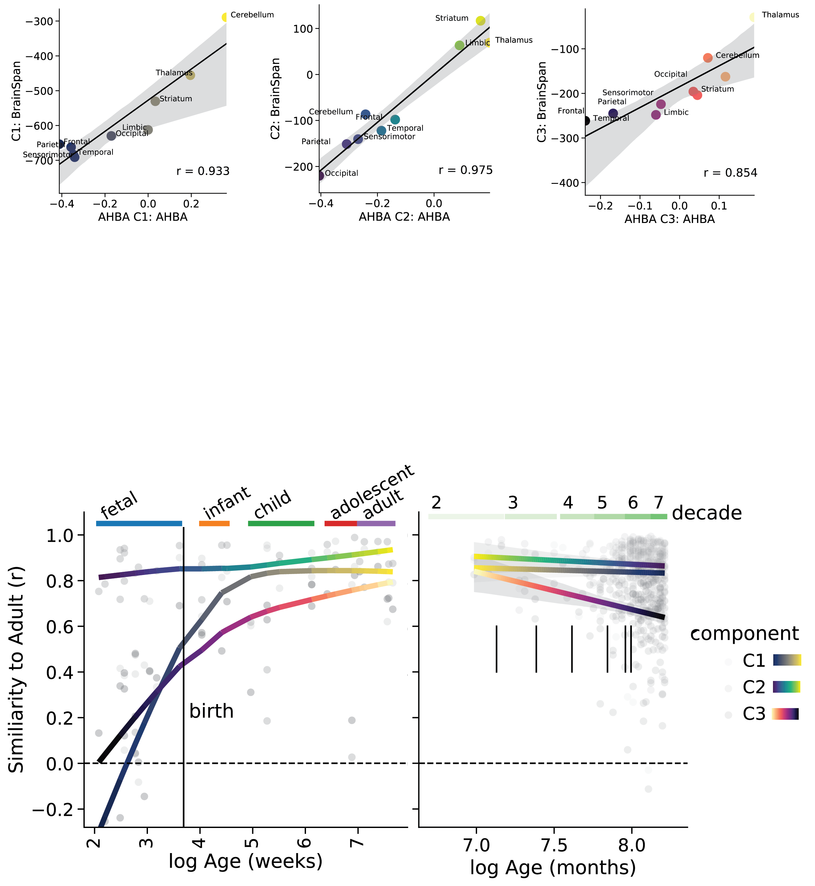
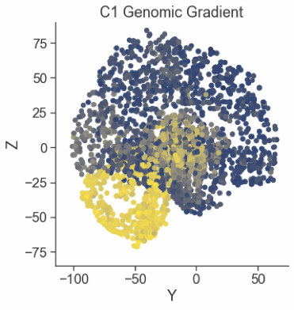
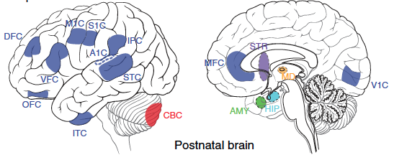
Brainspan

Slide 24
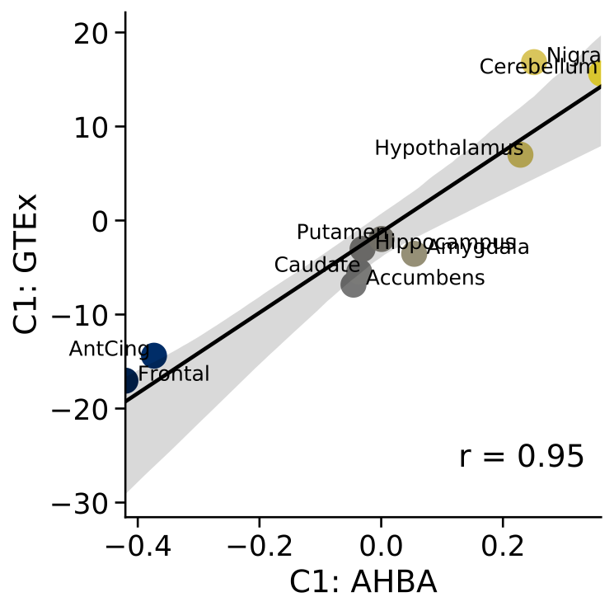


Brainspan
GTEx

Slide 25
Bioinformatics & Translation

Slide 26

Components — Cellular Organization
Major cell classes are differentiated by all components
Neuronal classes mostly differentiated by C3

Slide 27






Slide 28


Slide 29


Slide 30


GPX3 -> ALS
CD38 -> Parkinson’s
TRPS1 -> Brain volume, height, Neuroticism
MAOB -> Psychiatric Drug target
KCNA5 -> Receptor subtype
Gene X
Donors
Genes

Slide 31


Summary
Spatial gradients of gene expression
Reproducible within and across cohorts
Differential lifespan trajectories
Gradient-related genes are functionally relevant
Notes:
In summary, we identified patterns of gene expression that occurred systematically along spatial gradients in the brain. The components were reproducible across and within cohorts, and emerged prenatally. While it requires further follow-up work, these gradients may be involved in cortical arealization.

Slide 32
“Key Learnings”
Large-scale spatial Tx gradients are detectable in the adult brain
Gradients likely reflective of macroscopic brain organization
Adult gradients form along different timescales
D-V gradient: Develops paranatally, stable across lifespan
A-P gradient: detectable very early in development, stable across lifespan
M-L Gradient: Late-developing, degenerates w/ age, cell-type variation
Gradient-related genes associated with height and blood, among other phenotypes
Gradient formation may have functional consequences

Slide 33




Thank you!
UPenn
Aaron Alexander-Bloch
Max Bertolero
Ted Satterthwaite
Jakob Seidlitz
MNI
Boris Bernhardt
Alex Diaz-Papkovich
Thomas Funck
Ross Markello
Bratislav Misic
Casey Paquola
Cambridge
Konrad Wagstyl
Notes:
With that, I’d like to thank my co-authors, our funding bodies, the Allen Institute and BrainSpan datasets, and you for your attention.

Slide 34
Supplementary

Slide 35



Prediction x Slab

Slide 36

Rotations

Slide 37



Error x directions

Slide 38
Combined cortical projection
Notes:
We were interested in whether these whole-brain gradients might intersect and interact to promote cortical arealization. We regions that shared concentrations of different gradients. We tried this first for spatial gradients, and if one squints, one might recognize gross anatomical divisions of the cortex. We then repeated this exercise with the genomic gradients. This time, the gradients defined a sensorifugal axis, where primarysensory structures in dark grey were differentiated from sensory support structures in orange, and heteromodal cortex in blue and limbic structures in green.

Slide 39




Slide 40

Timeline
Fall 2018
Class Project
Summer 2020
OHBM
Winter 2020
Xmas Break
2021
Final Push
Bratislav Misic
Boris Bernhardt
Konrad Wagstyl
Casey Paquola
Alex Diaz-P
Thomas Funck
Ross Markello
Jakob Seidlitz
Aaron Alexander-Bloch
Ted Satterthwaite

